Slide 1
Chapter4
Elementary TCP Socket

Slide 2
abstract
Socket function
connect function
bind function
listen function
accept function
fork and exec function
concurrent server
close function
getsockname and getpeername function

Slide 3
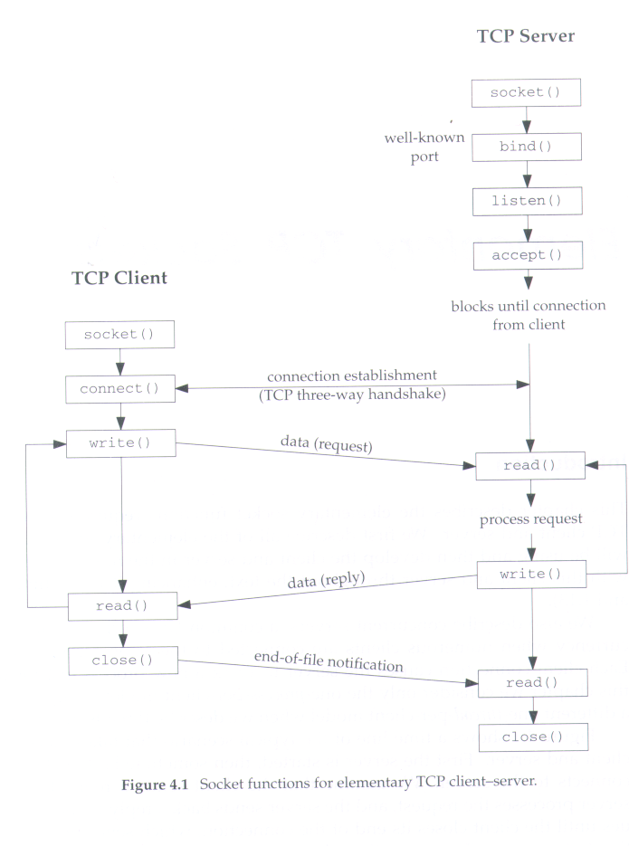
Socket function

Slide 4
#include <sys/socket.h>
int socket(int family, int type, int protocol);
returns:nonnegative descriptor if OK, -1 on error
==>Normaly the protocol argument to the socket function is set to 0 exept for raw socket.

Slide 5
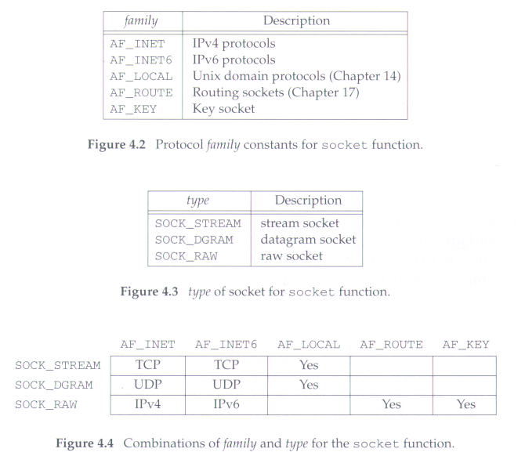

Slide 6
Connect function
#include <sys/socket.h>
int connect(int sockfd, const struct sockaddr *servaddr,
socklen_t addrlen);
Returns:0 if OK, -1 on error
==>this function used by a TCP client

Slide 7
Connect function
Return error
  ETIMEOUT : no response from server
  RST : server process is not running
  EHOSTUNREACH : client’s SYN unreachable from some intermediate router.

Slide 8
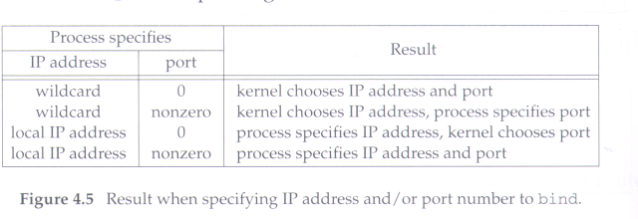
bind function
#include <sys/socket.h>
int bind (int sockfd, const struct sockaddr *myaddr, socklen_t addrlen);
    Returns: 0 if OK, -1 on error
  ==>this function assigns a local protocol address to a socket.

Slide 9
listen function
#include <sys/socket.h>
int listen(int sockfd, int backlog);
    Returns:0 if OK, -1 on error
==>This function is called only by a TCP server
backlog =>specify the maximum number of connections that the kernel should queue for this socket.
If the queues are full when client SYN arrives, TCP server ignore the SYN, it does not send RST.

Slide 10
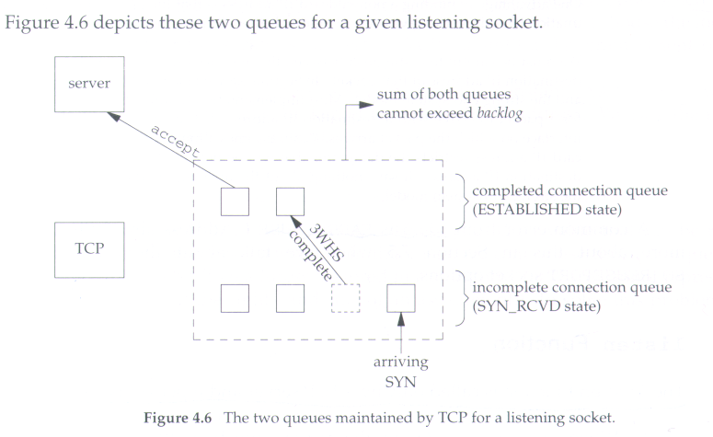
Backlog argument to the listen function has historically specified the maximum value for the sum of both queues

Slide 11
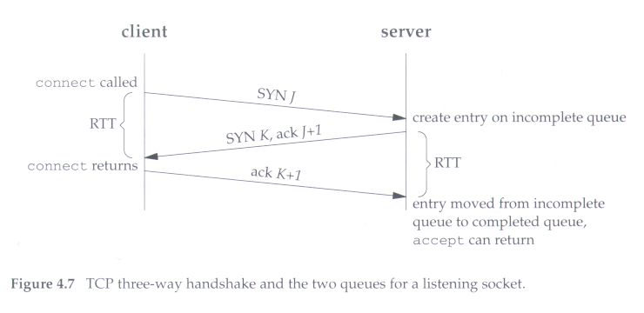

Slide 12
accept function
#include <sys/socket.h>
int accept(int sockfd, struct sockaddr *cliaddr,
socklen_t *addrlen);
      Returns:nonnegative descriptor if OK, -1 on error
  => return the next completed connection from the front of the completed connection queue.
  If queue is empty, the process is put to sleep.

Slide 13
#include "unp.h"
#include <time.h>
int main(int argc, char **argv)
{ int listenfd, connfd;
socklen_t len;
struct sockaddr_in servaddr, cliaddr;
char buff[MAXLINE];
time_t ticks;
listenfd = Socket(AF_INET, SOCK_STREAM, 0);
bzero(&servaddr, sizeof(servaddr));
servaddr.sin_family = AF_INET;
servaddr.sin_addr.s_addr = htonl(INADDR_ANY);
servaddr.sin_port = htons(13); /* daytime server */
Bind(listenfd, (SA *) &servaddr, sizeof(servaddr));
Listen(listenfd, LISTENQ);
for ( ; ; ) { len = sizeof(cliaddr);
connfd = Accept(listenfd, (SA *) &cliaddr, &len);
printf("connection from %s, port %d\n",
Inet_ntop(AF_INET, &cliaddr.sin_addr, buff, sizeof(buff)),
ntohs(cliaddr.sin_port));
ticks = time(NULL);
snprintf(buff, sizeof(buff), "%.24s\r\n", ctime(&ticks));
Write(connfd, buff, strlen(buff));
Close(connfd);
}
}
==>DayTime server that print client IP address and port.

Slide 14
fork and exec function
#include <unistd.h>
pid_t fork(void);
    Returns: 0 in child, process ID of child in parent, -1 on error
#include <unistd.h>
int execl(const char *pathname, const char *arg(), …/*(char *) 0*/);
int execv(const char *pathname, char *const argv[]);
int execle(const char *pathname, const char *arg());
int execve(const char *pathname, char *const argv[], char *const envp[]);
int execlp(const char *filename, const char *arg());
int execvp(const char *filename, char *const argv[]);
All six return: -1 on error, no return on success

Slide 15
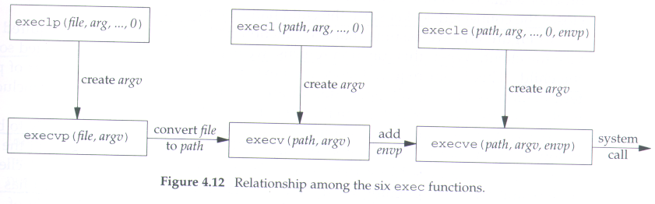

Slide 16
Concurrent server
pid_t pid
int listenfd, connfd;
listenfd = Socket(...);
//fill in sockaddr_in{} with server’s well-known port
Bind(listenfd, LISTENQ);
for(;;){
connfd = Accept(listenfd, ...);
doit(connfd); //process the request
Close(); //done with this client
exit(0); //child terminate
} Close(connfd); // parent close connected socket
}
Figure 4.13 Outline for typical concurrent server

Slide 17
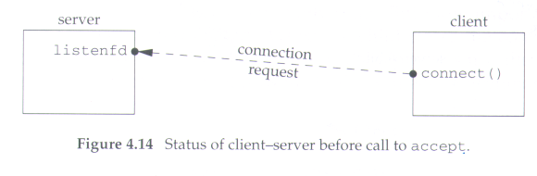
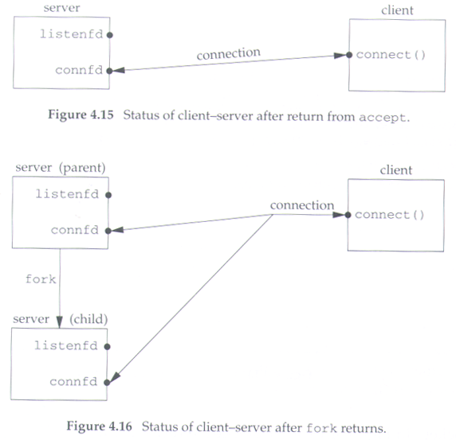

Slide 18
Close function
#include <unistd.h>
int close(int sockfd);
        returns:0 if OK, -1 on error

Slide 19
getsockname and getpeername function
#include<sys/socket.h>
int getsockname(int sockfd, struct sockaddr *localaddr, socklen_t *addrlen);
int getpeername(int sockfd, struct sockaddr *peeraddr, socklen_t *addrlen);
        both return : 0 if OK, -1 on error
=>getsockname : return local address associated with a socket
getpeername : foreign protocol address associated with a socket

Slide 20
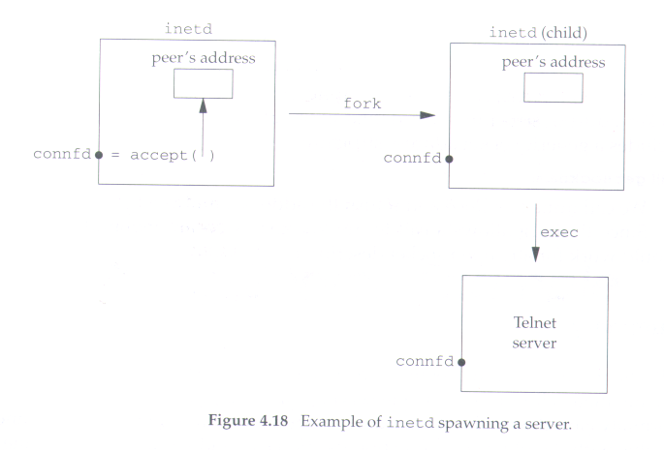

Slide 21
#include "unp.h"
int sockfd_to_family(int sockfd)
{
union {
struct sockaddr sa;
char data[MAXSOCKADDR];
} un;
socklen_t len;
len = MAXSOCKADDR;
if (getsockname(sockfd, (SA *) un.data, &len) < 0)
return(-1);
return(un.sa.sa_family);
}
Figure 4.19 Return the address family of a socket

